Slide 1
When will Leaders of Developing Countries Negotiate South-North Preferential Trade Agreements?
Lucie Lu Department of Political Science
University of Illinois at Urbana-Champaign
Notes:
Hi

Slide 2
Outline of Today’s Presentation
Introduction and Research Question
Context and Rationale
Theory: The Logic of Economic Reforms
Power dynamics between oppositions and leaders
Research Design
Empirical Findings at this Stage
Tentative Conclusions
Questions and Comments

Slide 3
Introduction
Case of South Africa in 1994: PTA with EU helped with the economic transition in South Africa
Preferential trade agreements (PTAs) are binding international treaties that help states to foster trade and economic integration among member-states.
Focus: Bilateral South-North Preferential Trade Agreements

Slide 4
Research question
Under what conditions will leaders in the developing countries negotiate the South-North Preferential Trade Agreements with required structural economic reforms?

Slide 5
Context and Rationale
Current literature on the preferential trade agreement mainly focuses on the effects of this institution.
In contrast, explain why states form the PTAs:
The political purposes of the leaders in the developing countries to sign trade treaties are currently understudied.

Slide 6
Context and Rationale
The puzzles are: What motivates leaders to participate in this costly game? When is the optimal time to do so?
This paper focuses on the strategic behaviors of leaders to form PTAs to consolidate their power vis-à-vis the opposition.

Slide 7
Theory: The Logic of Economic Reforms
Leaders of developing countries: they anticipate a forthcoming structural economic transformation before the negotiation.
Domestic economic reforms usually provoke controversy and organized opposition.
PTA is an effective instrument for promoting such economic reform.
Argument: The leaders in the developing countries choose to sign the PTAs to lock in the economic reforms for the primary goal of political survival.

Slide 8
Research Design I
Quasi-experiment:
Treatment: leaders with insecure shocks
Empirically, how should I conceptualize an insecure shock?
Measuring a leader’s secureness at time 0 and over time
Unit of analysis: leader in the developing countries
Cases: 94 leaders in autocracies, covering 31 countries between 1995-2005
Compares the likelihoods of leaders with insecure shocks and without the insecure shocks to negotiate the South-North PTAs.

Slide 9
Research Design II:
Hypothesis:
Insecure shocks PTA Negotiation
Coding Strategies and Justifications:
Dependent Variable
Independent Variable
Control Variables:
Leaders’ tenure
GDP growth
Human rights conditions

Slide 10
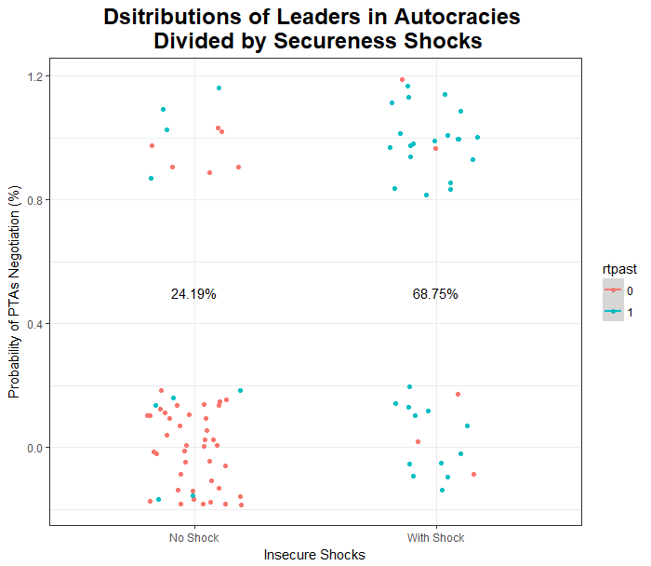
Empirical Findings: Data Description

Slide 11
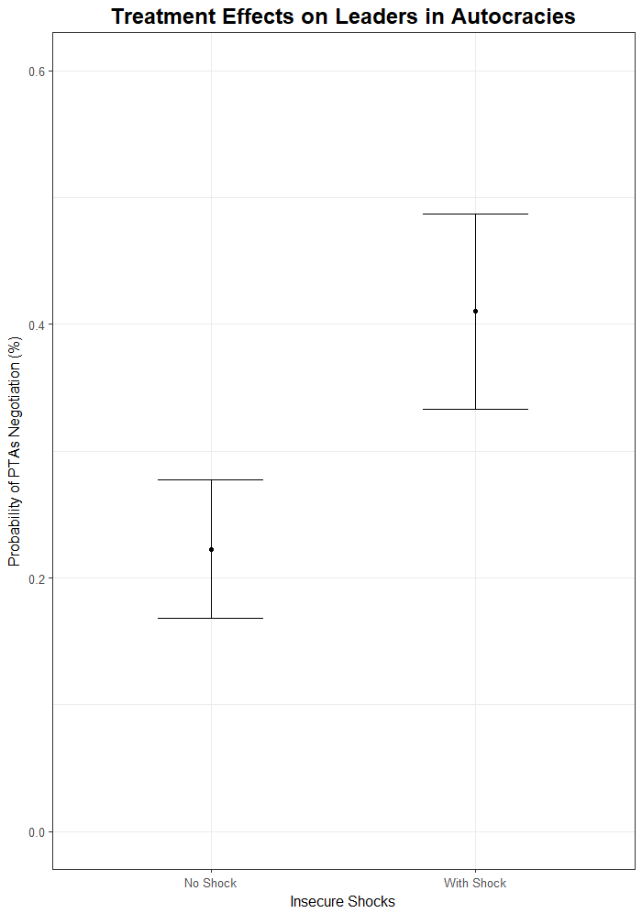
Empirical Findings: Treatment Effect with One Covariate
Those leaders who have experienced insecure shocks were on average 18% more likely to negotiate a PTA than those without such "treatment".

Slide 12
Preliminary Conclusions
My hypothesis is empirically supported.
Next steps:
Expand the datasets to include unstable democracies cases
More concrete qualitative cases to test the theory
Notes:
hello

Slide 13
Questions and Comments are Greatly Appreciated! Thank you very much.

